Slide 1

Limits
RCET 0264 Introductory Calculus
Tim Leishman

Slide 2
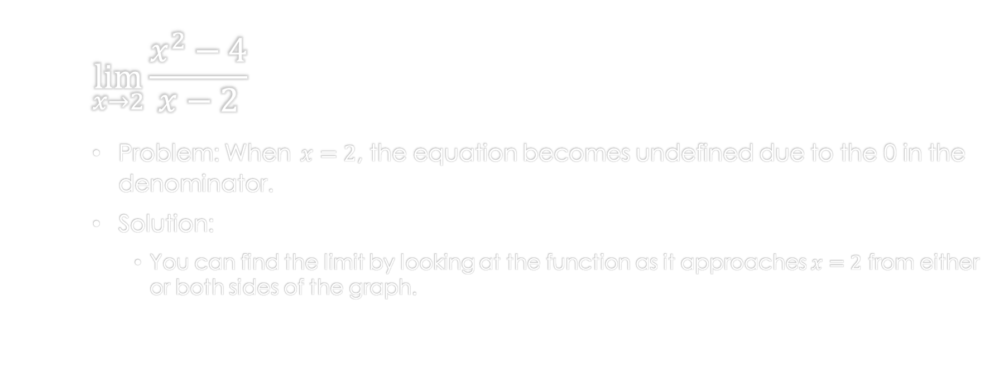
Limits
$$\lim_{x→2}{\frac{x^{2}−4}{x−2}}$$
Problem: When $x=2$, the equation becomes undefined due to the 0 in the denominator.
Solution:
You can find the limit by looking at the function as it approaches $x=2$ from either or both sides of the graph.

Slide 3
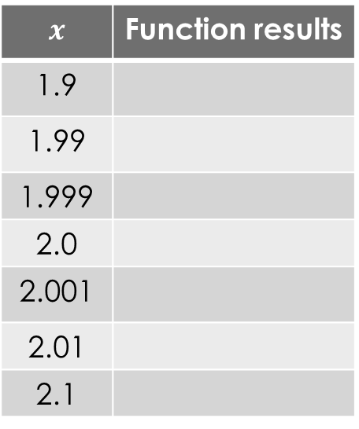
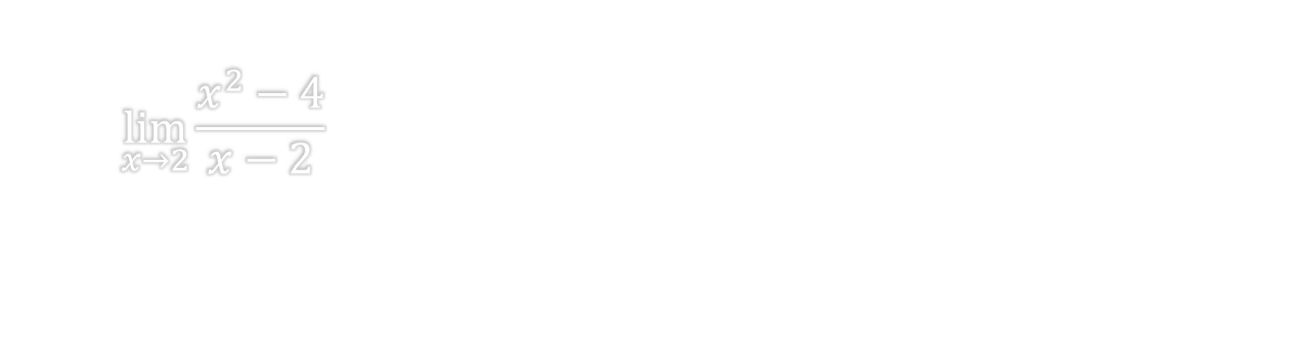
Limits
$$\lim_{x→2}{\frac{x^{2}−4}{x−2}}$$
$$x$$ | Function results
1.9
1.99
1.999
2.0
2.001
2.01
2.1

Slide 4
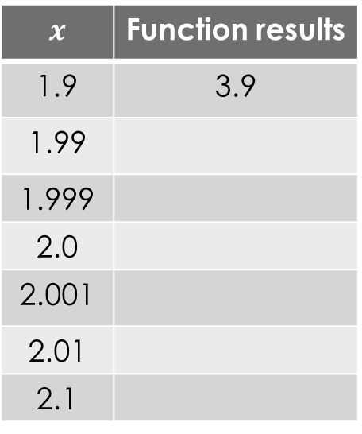
Limits
$$\lim_{x→2}{\frac{x^{2}−4}{x−2}}$$
$$x$$ | Function results
1.9 | 3.9
1.99
1.999
2.0
2.001
2.01
2.1

Slide 5
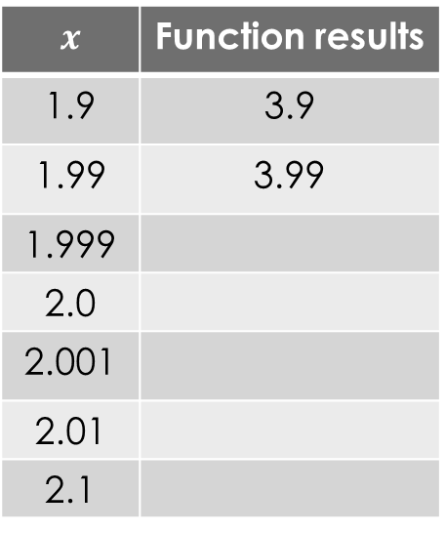
Limits
$$\lim_{x→2}{\frac{x^{2}−4}{x−2}}$$
$$x$$ | Function results
1.9 | 3.9
1.99 | 3.99
1.999
2.0
2.001
2.01
2.1

Slide 6
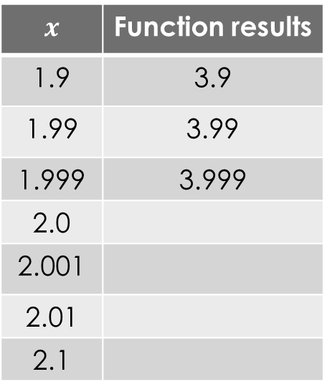
Limits
$$\lim_{x→2}{\frac{x^{2}−4}{x−2}}$$
$$x$$ | Function results
1.9 | 3.9
1.99 | 3.99
1.999 | 3.999
2.0
2.001
2.01
2.1

Slide 7
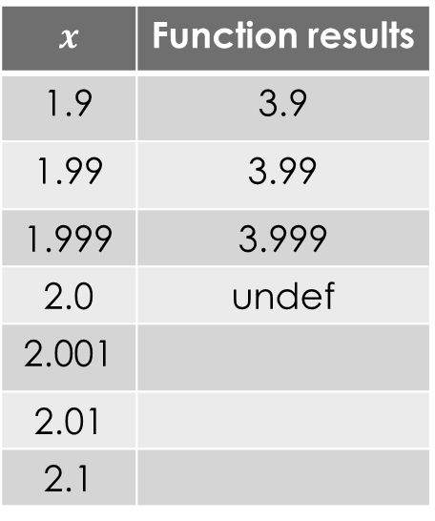
Limits
$$\lim_{x→2}{\frac{x^{2}−4}{x−2}}$$
$$x$$ | Function results
1.9 | 3.9
1.99 | 3.99
1.999 | 3.999
2.0 | undef
2.001
2.01
2.1

Slide 8
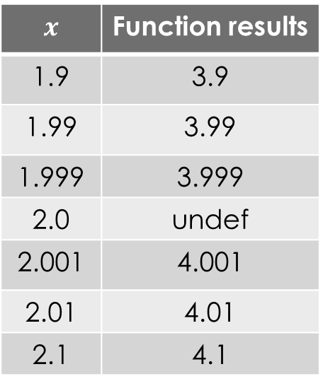
Limits
$$\lim_{x→2}{\frac{x^{2}−4}{x−2}}$$
$$x$$ | Function results
1.9 | 3.9
1.99 | 3.99
1.999 | 3.999
2.0 | undef
2.001 | 4.001
2.01 | 4.01
2.1 | 4.1

Slide 9
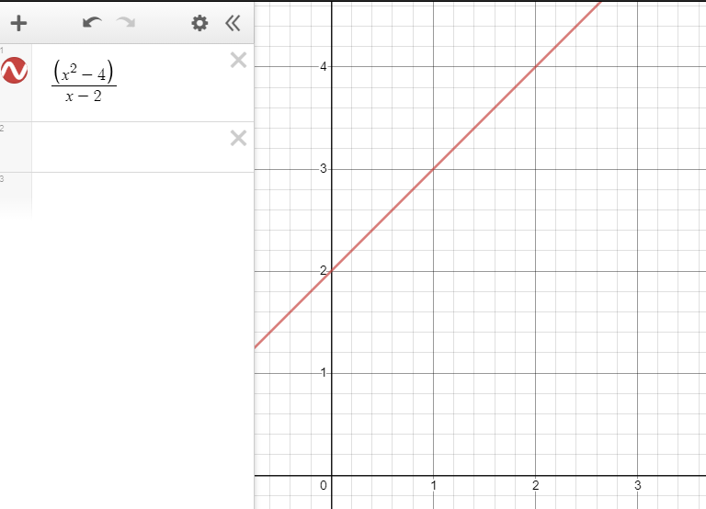
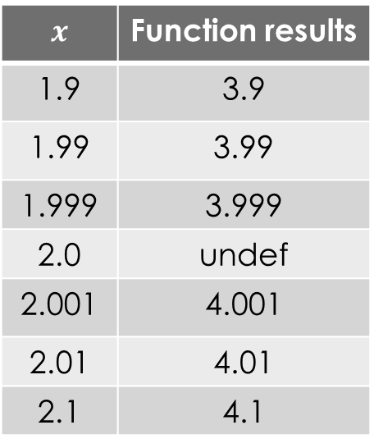
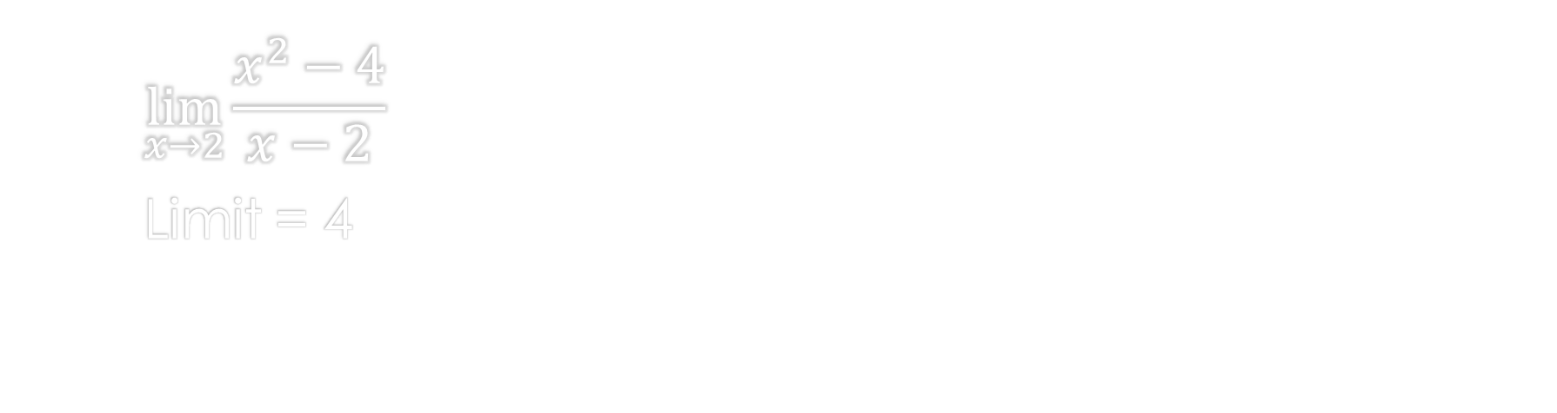
Limits
$$\lim_{x→2}{\frac{x^{2}−4}{x−2}}$$
Limit = 4
$$x$$ | Function results
1.9 | 3.9
1.99 | 3.99
1.999 | 3.999
2.0 | undef
2.001 | 4.001
2.01 | 4.01
2.1 | 4.1

Slide 10
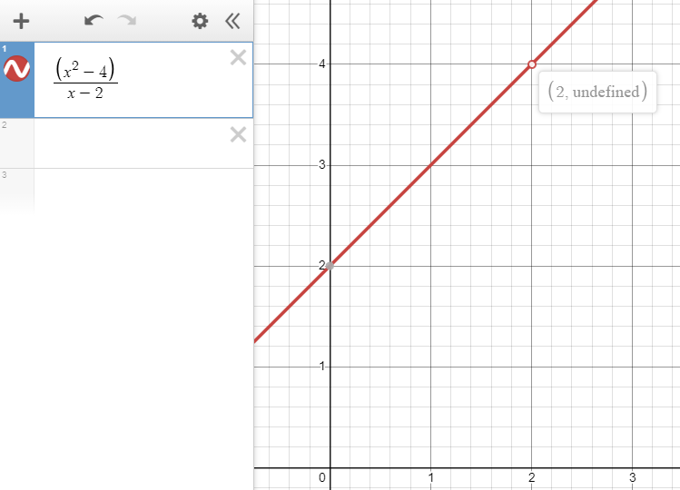
Limits
$$\lim_{x→2}{\frac{x^{2}−4}{x−2}}$$
Limit = 4
$$x$$ | Function results
1.9 | 3.9
1.99 | 3.99
1.999 | 3.999
2.0 | undef
2.001 | 4.001
2.01 | 4.01
2.1 | 4.1

Slide 11
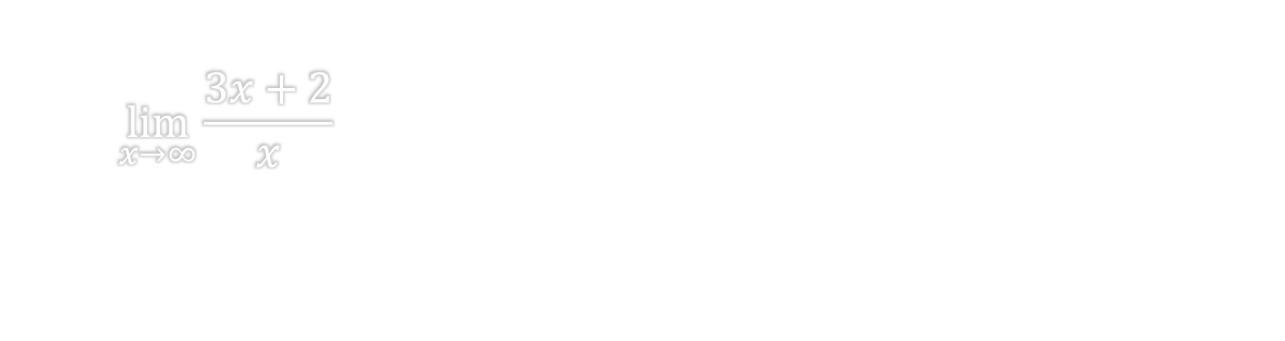
Limits
$$\lim_{x→∞}{\frac{3x+2}{x}}$$

Slide 12
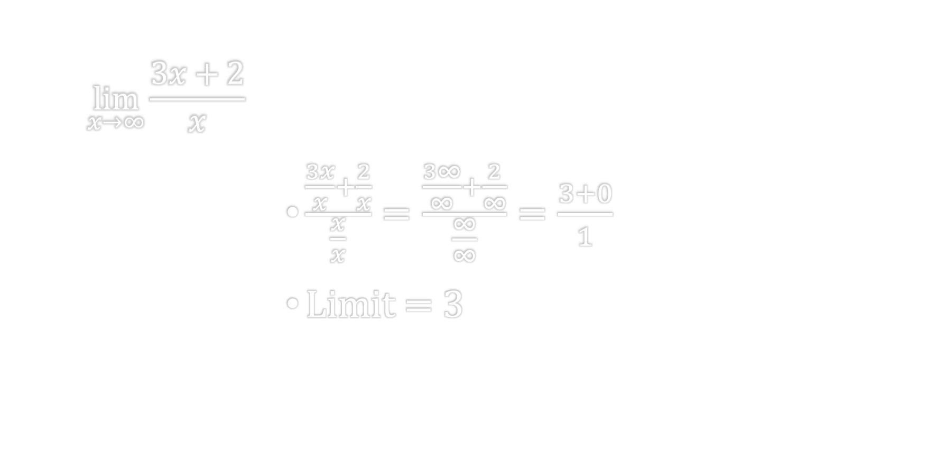
Limits
$$\lim_{x→∞}{\frac{3x+2}{x}}$$
$\frac{\frac{3x}{x}+\frac{2}{x}}{\frac{x}{x}}=$ $\frac{\frac{3∞}{∞}+\frac{2}{∞}}{\frac{∞}{∞}}=$ $\frac{3+0}{1}$
Limit = 3

Slide 13
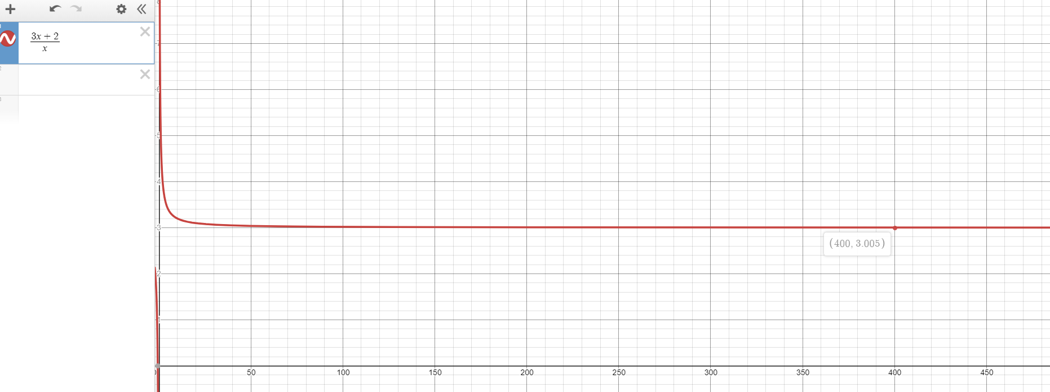
Limits
$\lim_{x→∞}{\frac{3x+2}{x}}$ Limit = 3

Slide 14
References:
Ewen, D., Gary, J. S., & Trefzger, J. E. (2005). Technical calculus. Upper Saddle River, NJ: Pearson/Prentice Hall.
Richmond, A. E., & Hecht, G. W. (1989). Calculus for electronics. New York: McGraw-Hill.

